Slide 1
Vanishing Point Detection
Harry Beggs

Slide 2
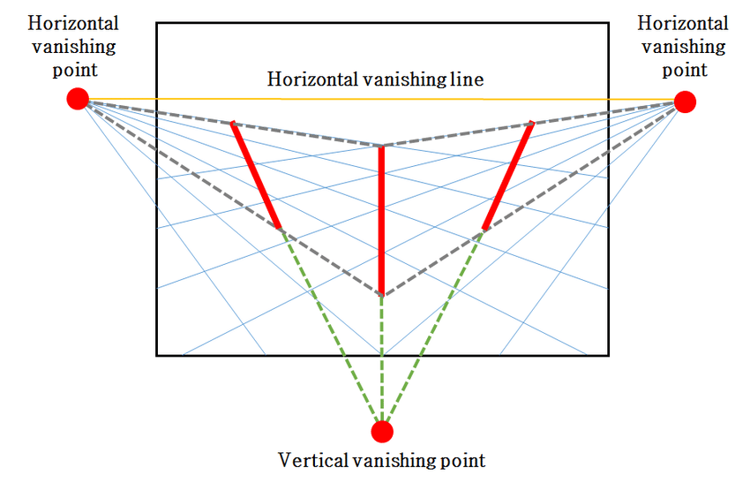
The problem
Vanishing points have many real world uses such as self driving cars, camera calibration, scene analysis, etc
These applications often are reliant on time constraints
What is the most efficient method to carry out vanishing point detection?

Slide 3
Detection methods
Texture based methods found textures within the image and calculated their orientation
Learning based methods used neural networks to learn the relationship between vanishing points and perspective
Edge based methods work out where lines are in a scene and where they intersect

Slide 4
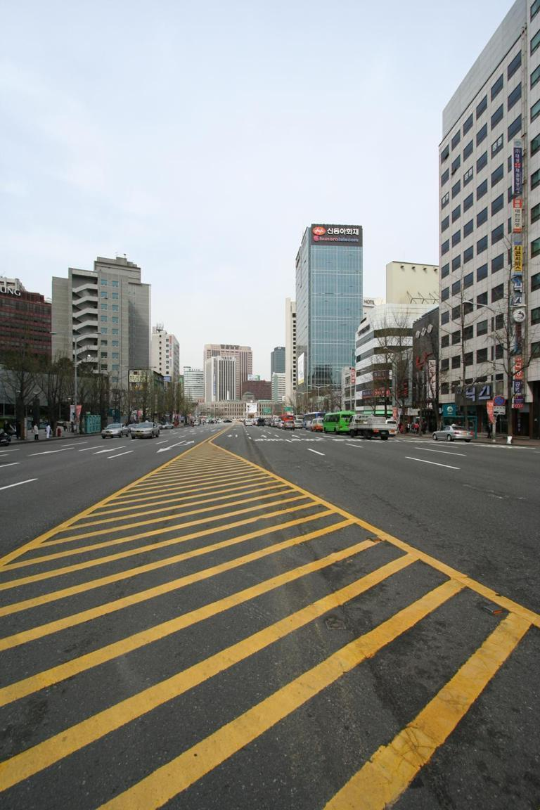
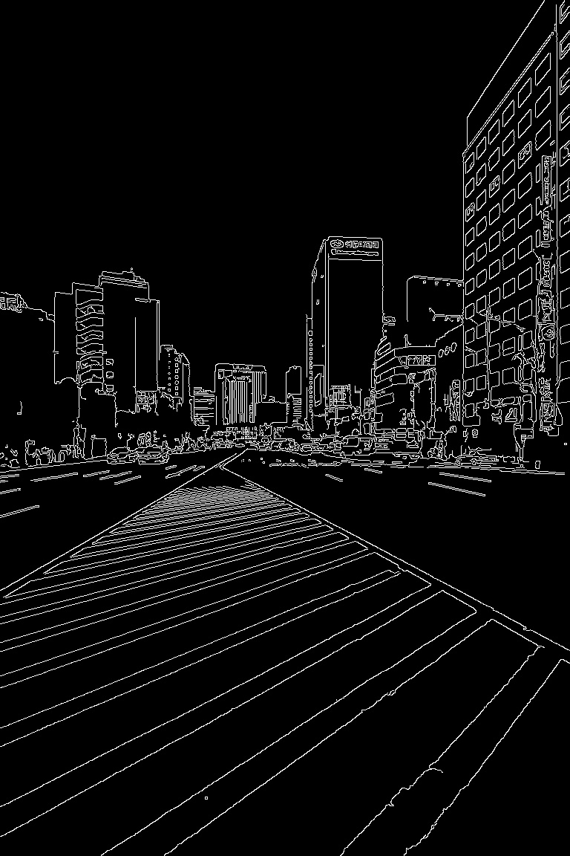
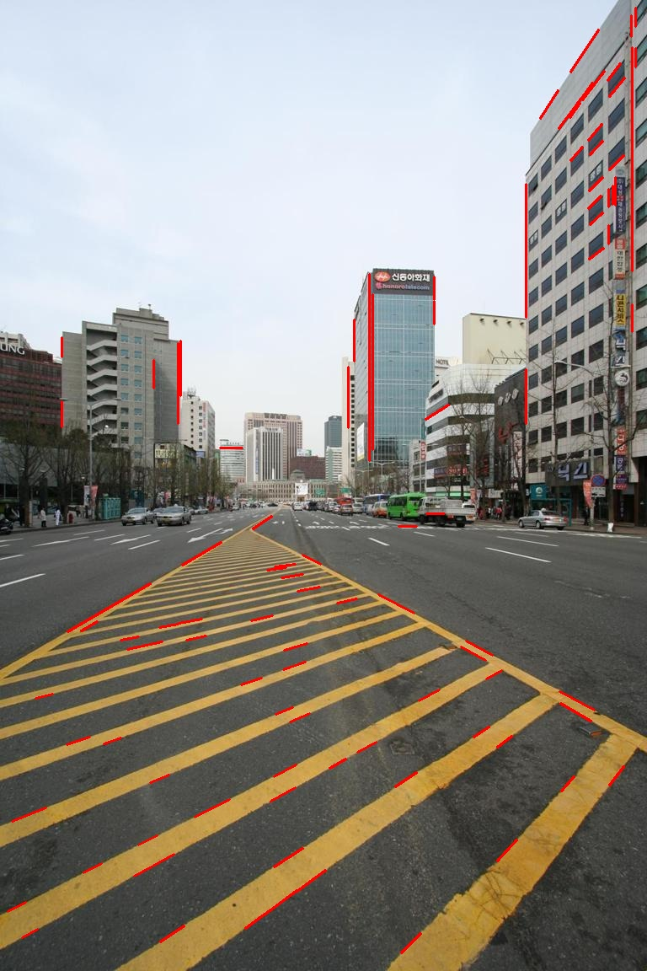
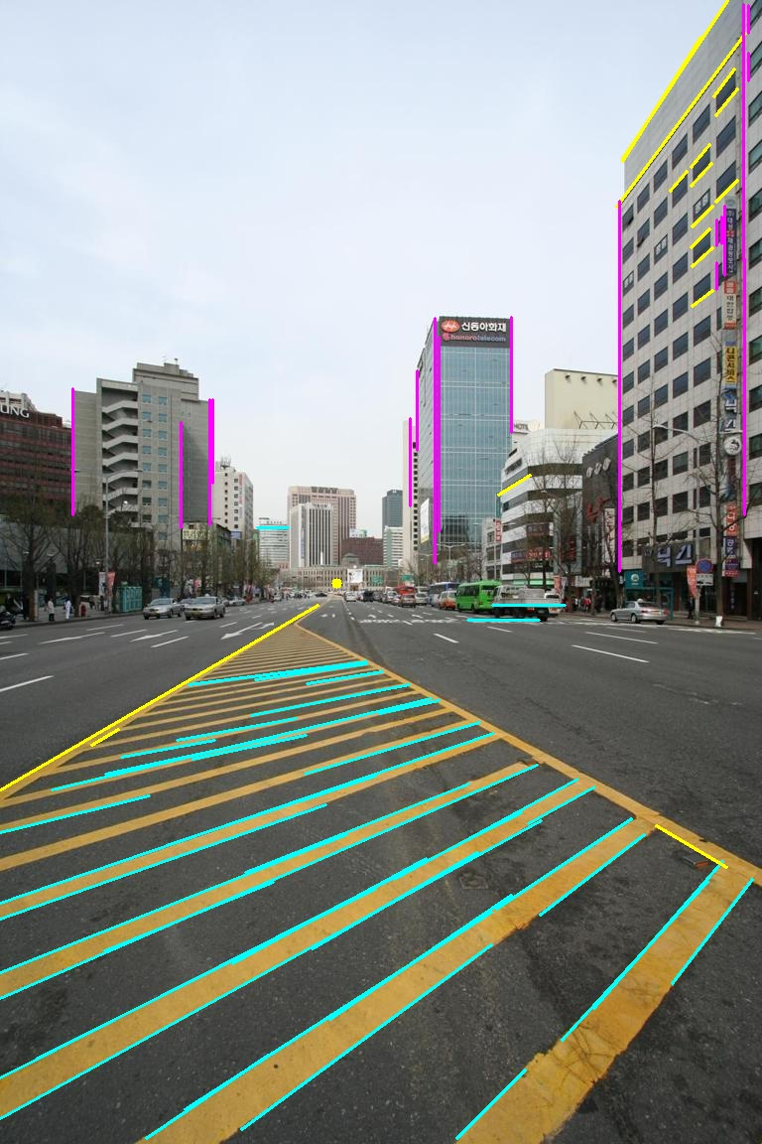
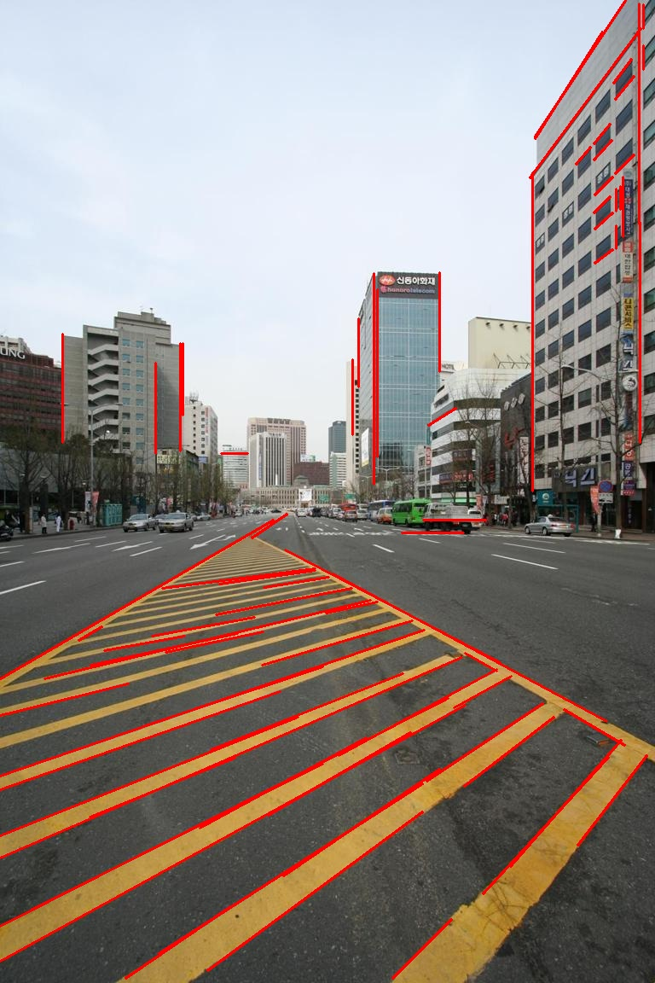
General edge based implementation
Edge Detection
Line Extraction
Line Clustering and VP Estimation
Line Grouping

Slide 5
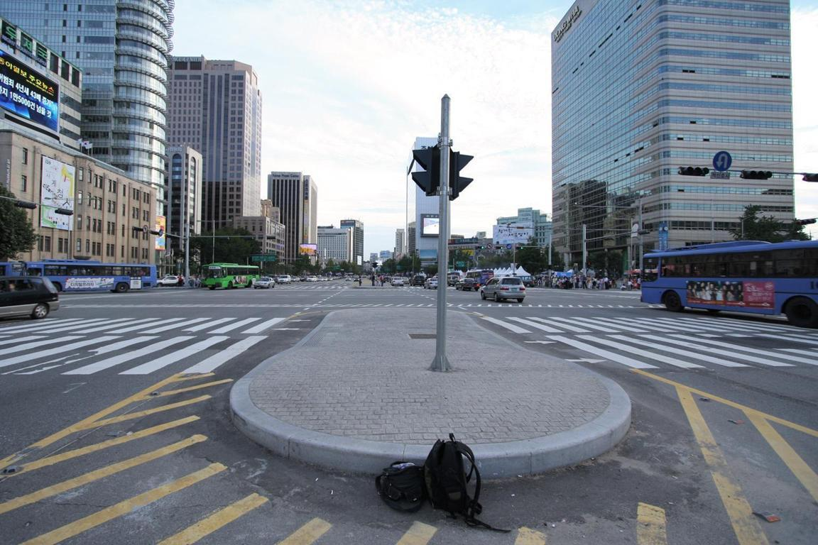


Datasets
3 datasets used, Eurasian Cities, York Urban Cities and Toulouse
Eurasian York Toulouse
Notes:
Eurasian – 103 outdoor urban a resolution of 1152 × 768 and also files containing ground truth vanishing points and line segments
an scenes York Urban Cities – 102 images of urban environments, 45 indoor and 57 outdoor, each image at a resolution of 640 x 480 and also includes ground truth vanishing points and line segments
Toulouse – 114 images with a resolution of 1920 x 1080, with ground truth line segment end points and which vanishing point they are associated with but not he vanishing point itself

Slide 6
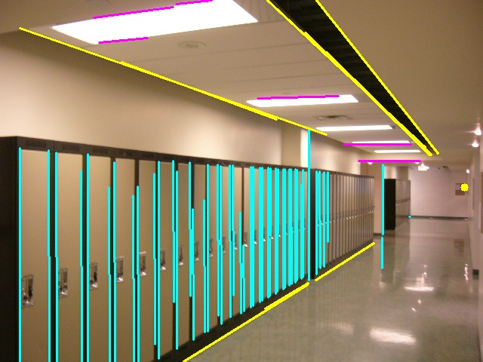
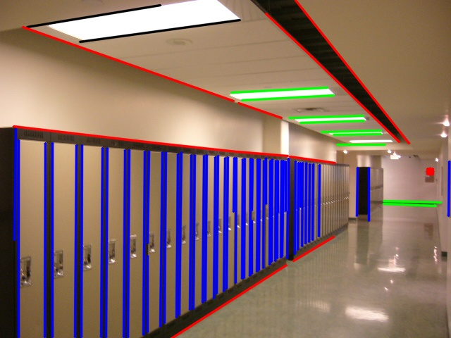
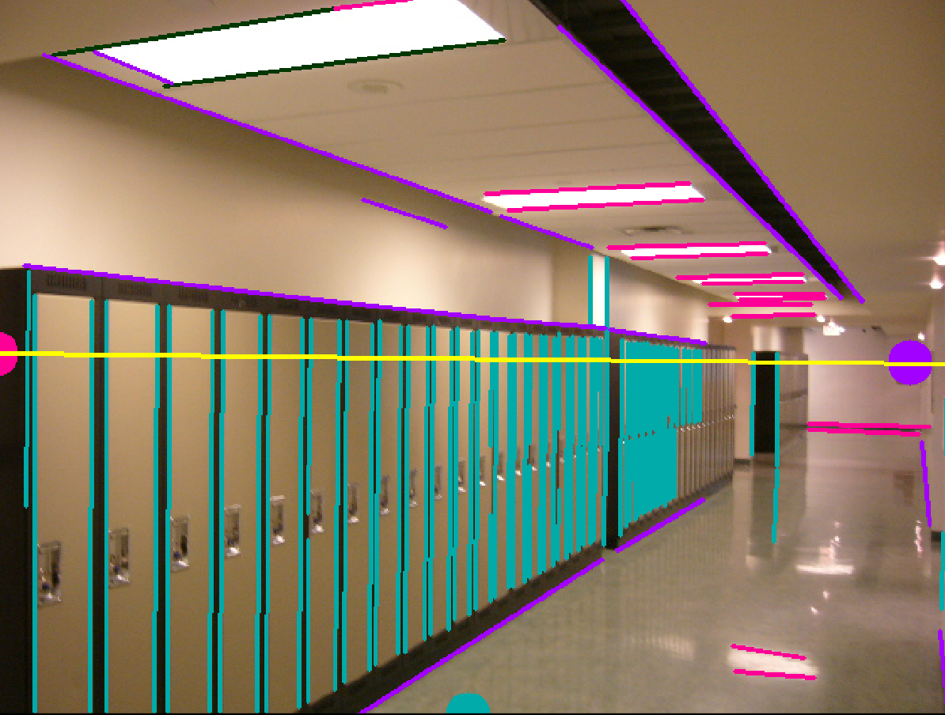
Resulting image output
Symen Yang Xiao Hu Lu VP toolbox

Slide 7
Eurasian Cities Results
File | Actual Vanishing Point | Xiaohu Lu results | Symen Yang results
001 | 518.85, 392.00 | 517.42, 388.67 (Distance 3.62) | 413.64, 377.39 (Distance 106.22)
007 | 605.74, 511.36 | 513.12, 500.49 (Distance 93.26) | 516.58, 484.94 (Distance 92.99)
018 | 1220.90, 508.38 | 1240.00, 510.50 (Distance 19.22) | 1194.61, 480.62 (Distance 38.23)
028 | 1440.73, 648.54 | 1479.48, 667.85 (Distance 43.29) | 1423.83, 630.69 (Distance 24.58)
030 | -248.89, 593.12 | -250.89, 589.23 (Distance 4.37) | -239.32, 601.54 (Distance 12.75)
040 | -225.05, 536.90 | -230.80, 528.39 (Distance 10.27) | -161.98, 500.47 (Distance 72.84)

Slide 8
York Urban Results
File | Ground Truth Vanishing point | Xiao Hu Lu results | Symen Yang results | VP toolbox results
P1020171 | 824.769, 317.743 | 878.987, 326.098 Distance= 54.858 | 885.955, 314.552 Distance= 61.269 | 849.699, 320.144 Distance= 25.045353
P1020177 | 754.234, 410.580 | -749.787, 383.083 Distance= 1504.272 | 743.567, 392.299 Distance= 21.166 | 887.806, 455.507 Distance= 140.925
P1020928 | -168.440, 80.020 | -200.598, 56.896 Distance= 39.609 | -127.987, 90.579 Distance= 41.808 | -179.939, 61.184 Distance= 22.069
P1020838 | 1200.071, 138.567 | 1389.137, 148.045 Distance= 189.303 | 1458.417, 156.959 Distance= 259.000 | 1392.984, 142.770 Distance= 192.95878
P1020839 | 602.337, 251.043 | 610.138, 243.625 Distance= 10.765 | 615.358, 248.013 Distance= 13.369 | 612.747, 244.957 Distance= 12.059
P1030839 | 509.919, 238.794 | 508.722, 238.470 Distance= 1.240 | 507.583, 231.843 Distance= 7.333 | 510.879, 233.289 Distance= 5.588
Notes:
P1020177 = 27.854278

Slide 9
Toulouse Results
File | Ground Truth Vanishing point | Xiao Hu Lu results | Symen Yang results | VP toolbox results
Img_1331 | 2177.252, 1014.904 | 1866.667, 897.009 Distance= 332.208 | 2103.969, 975.227 Distance= 83.335 | 2165.319, 1003.862 Distance= 16.258
Img_1741* | 2173.620, 537.400 | 2033.537, -422.232 Distance= 969.802 | 2939.002, 412.333 Distance= 775.533 | 2118.581, -483.760 Distance= 1022.642
Img_1793 | 2482.327, 785.139 | 2362.560, 749.326 Distance= 125.007 | 2398.530, 754.101 Distance= 89.360 | 2483.527, 789.464 Distance= 4.488
Img_1842 | 2830.747, 712.845 | 2421.523, 667.867 Distance= 411.688 | -335.120, 714.022 | 2876.497, 727.725 Distance= 48.109
Img_1893 | 376.401, 731.196 | 336.434, 748.795 Distance= 43.670 | 351.197, 745.274 Distance= 28.869 | 332.406, 748.671 Distance= 47.339

Slide 10
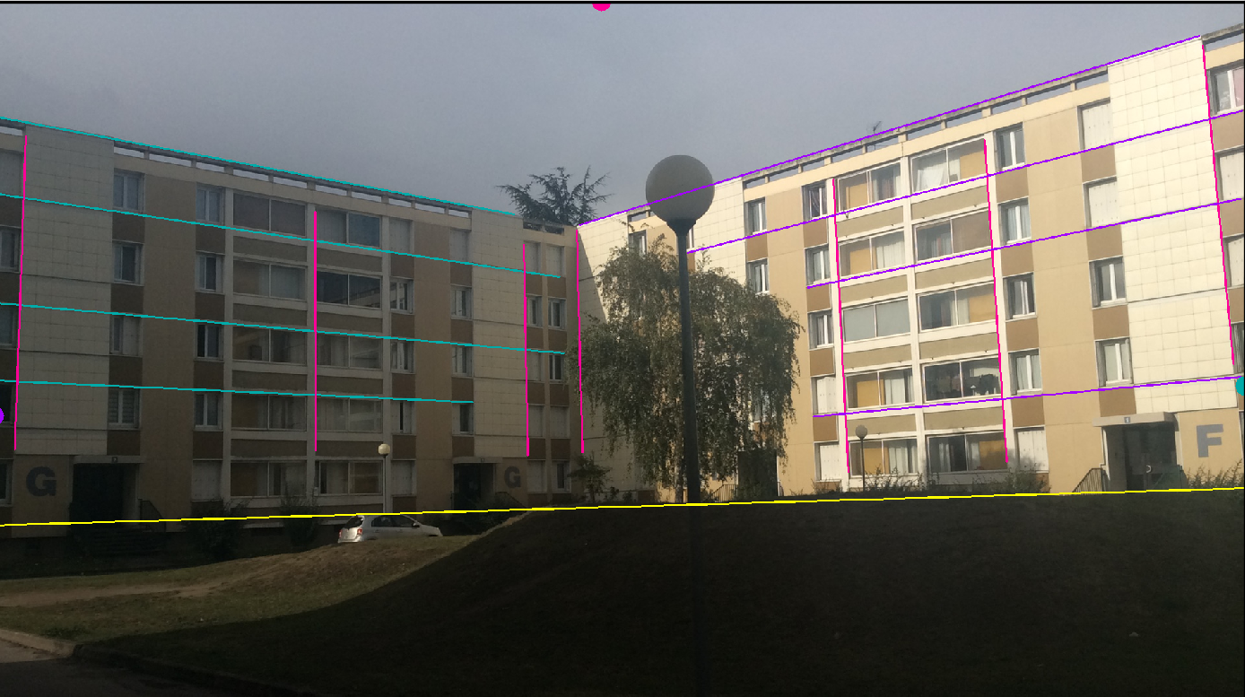
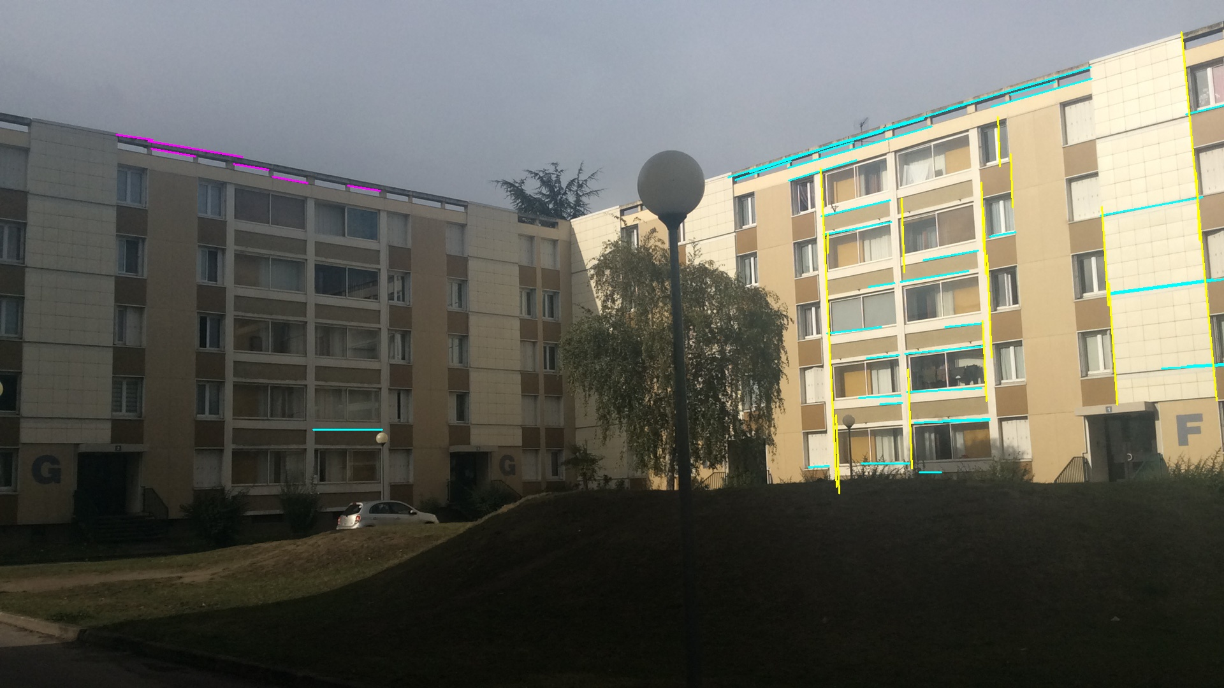
Img_1842

Slide 11
Thanks for listening. Any Questions?

